Slide 1
Store Sales Prediction.

Slide 2
Objective:
Objective of the model is to predict the sales of the bigmart stores.
Benefits:
Help in sales calculation.
Gives better insight of customers.
Very easy to use.

Slide 3
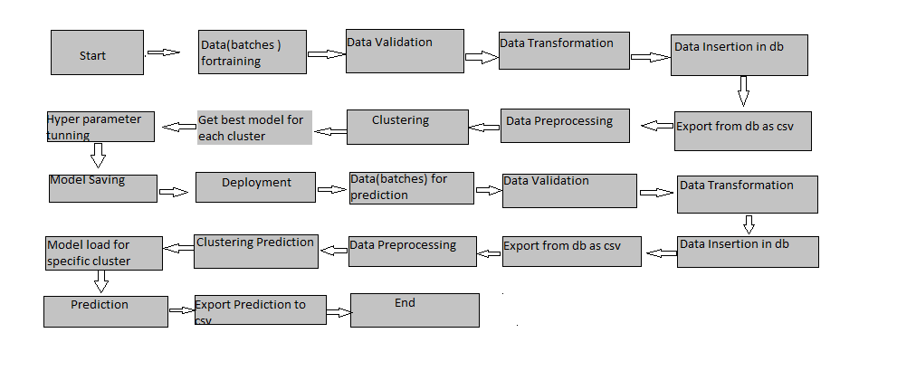
Architecture

Slide 4
Data Validation and Data Transformation :
Data is collected and cleaned and then preprocessed for the further EDA.

Slide 5
Model Training:
Data Export from Db :
The accumulated data from db is exported in csv format for model training
Data Preprocessing
Performing EDA to get insight of data like identifying distribution , outliers ,trend
among data etc.
Check for null values in the columns. If present impute the null values.
Encode the categorical values with numeric values.
Perform Standard Scalar to scale down the values.

Slide 6
Prediction:
For the Prediction we use elastic net regression..
Best model is selected with 55% score.

Slide 7
Q & A:
Q1) What’s the source of data?
Data is Provided in the Csv format
Q 2) What was the type of data?
The data was the combination of numerical and Categorical values.
Q 3) What’s the complete flow you followed in this Project?
Refer slide 5th for better Understanding

Slide 8
Q 5) How logs are managed?
We are using different logs as per the steps that we follow in validation and
modeling like File validation log , Data Insertion ,Model Training log , prediction log
etc.
Q 6) What techniques were you using for data pre-processing?
Removing unwanted attributes
Visualizing relation of independent variables with each other and output variables
Checking and changing Distribution of continuous values
Removing outliers
Cleaning data and imputing if null values are present.
Converting categorical data into numeric values.
Scaling the data

Slide 9
Q 7) How training was done or what models were used?
Before diving the data in training and validation set we performed clustering over fit to divide the data into clusters.
Here, we will use linear regression and elastic regression.
Q 8) How Prediction was done?
The testing files are shared by the client .We Perform the same life cycle till we get the output through elastic net regression.. In the end we get the accumulated data of predictions.

